Slide 1
Partnership Proposal between ATOVA CONSEIL and [Target Company Name]
Enable you to offer your expertise within training programs and thus increase your revenue.

Slide 2
Presentation of the services offered
I am Fabien Ben Sadoun, CEO of Atova Conseil, a training company that has been helping businesses develop their skills since 2010. We offer a wide range of training programs that cater to the needs of our clients.
I aim to assist you in strengthening your business through two services:
1. Training Program Promotion: We can promote your training programs on our highly ranked and constantly evolving website. This service ensures maximum visibility and exposure for your offerings, reaching a wider audience and potential clients.
2. Administrative Management Service (Qualiopi Portage): We offer an administrative management service, specifically the Qualiopi portage, which allows you to offer your training programs to clients while making them eligible for deduction from their training budgets and OPCO funding. This service relieves you of the administrative burdens associated with managing a training center, enabling you to focus on delivering quality training.
Our goal is to provide you with comprehensive support, helping you expand your reach, enhance your offerings, and streamline administrative processes. We look forward to discussing how our services can benefit your business and contribute to its growth.
I am looking for partners!

Slide 3

The key principles of corporate training and the definition of Qualiopi portage:
In France, continuous professional training is important for developing employees' skills. The government encourages companies to invest in training by offering financial incentives. Competence operators (OPCOs) were created to manage the funds for professional training. Every company is obligated to pay a tax that is collected and used for training purposes.
Since 2022, training providers who want to access these funds must obtain Qualiopi certification for their services to be considered deductible from their clients' training budgets. Atova Conseil holds this certification to offer high-quality training that complies with national standards, making it eligible for deduction.
Qualiopi portage is a process that allows a certified training organization to extend its certification to a non-certified trainer or company. This means that the certified organization takes responsibility for the quality of the training offered by the non-certified trainer or company.
Furthermore, training can be a way for you and your teams to enhance your reputation and identify potential target markets.
La certification qualité a été délivrée à ATOVA CONSEIL au titre de la catégorie ACTION DE FORMATION.

Slide 4
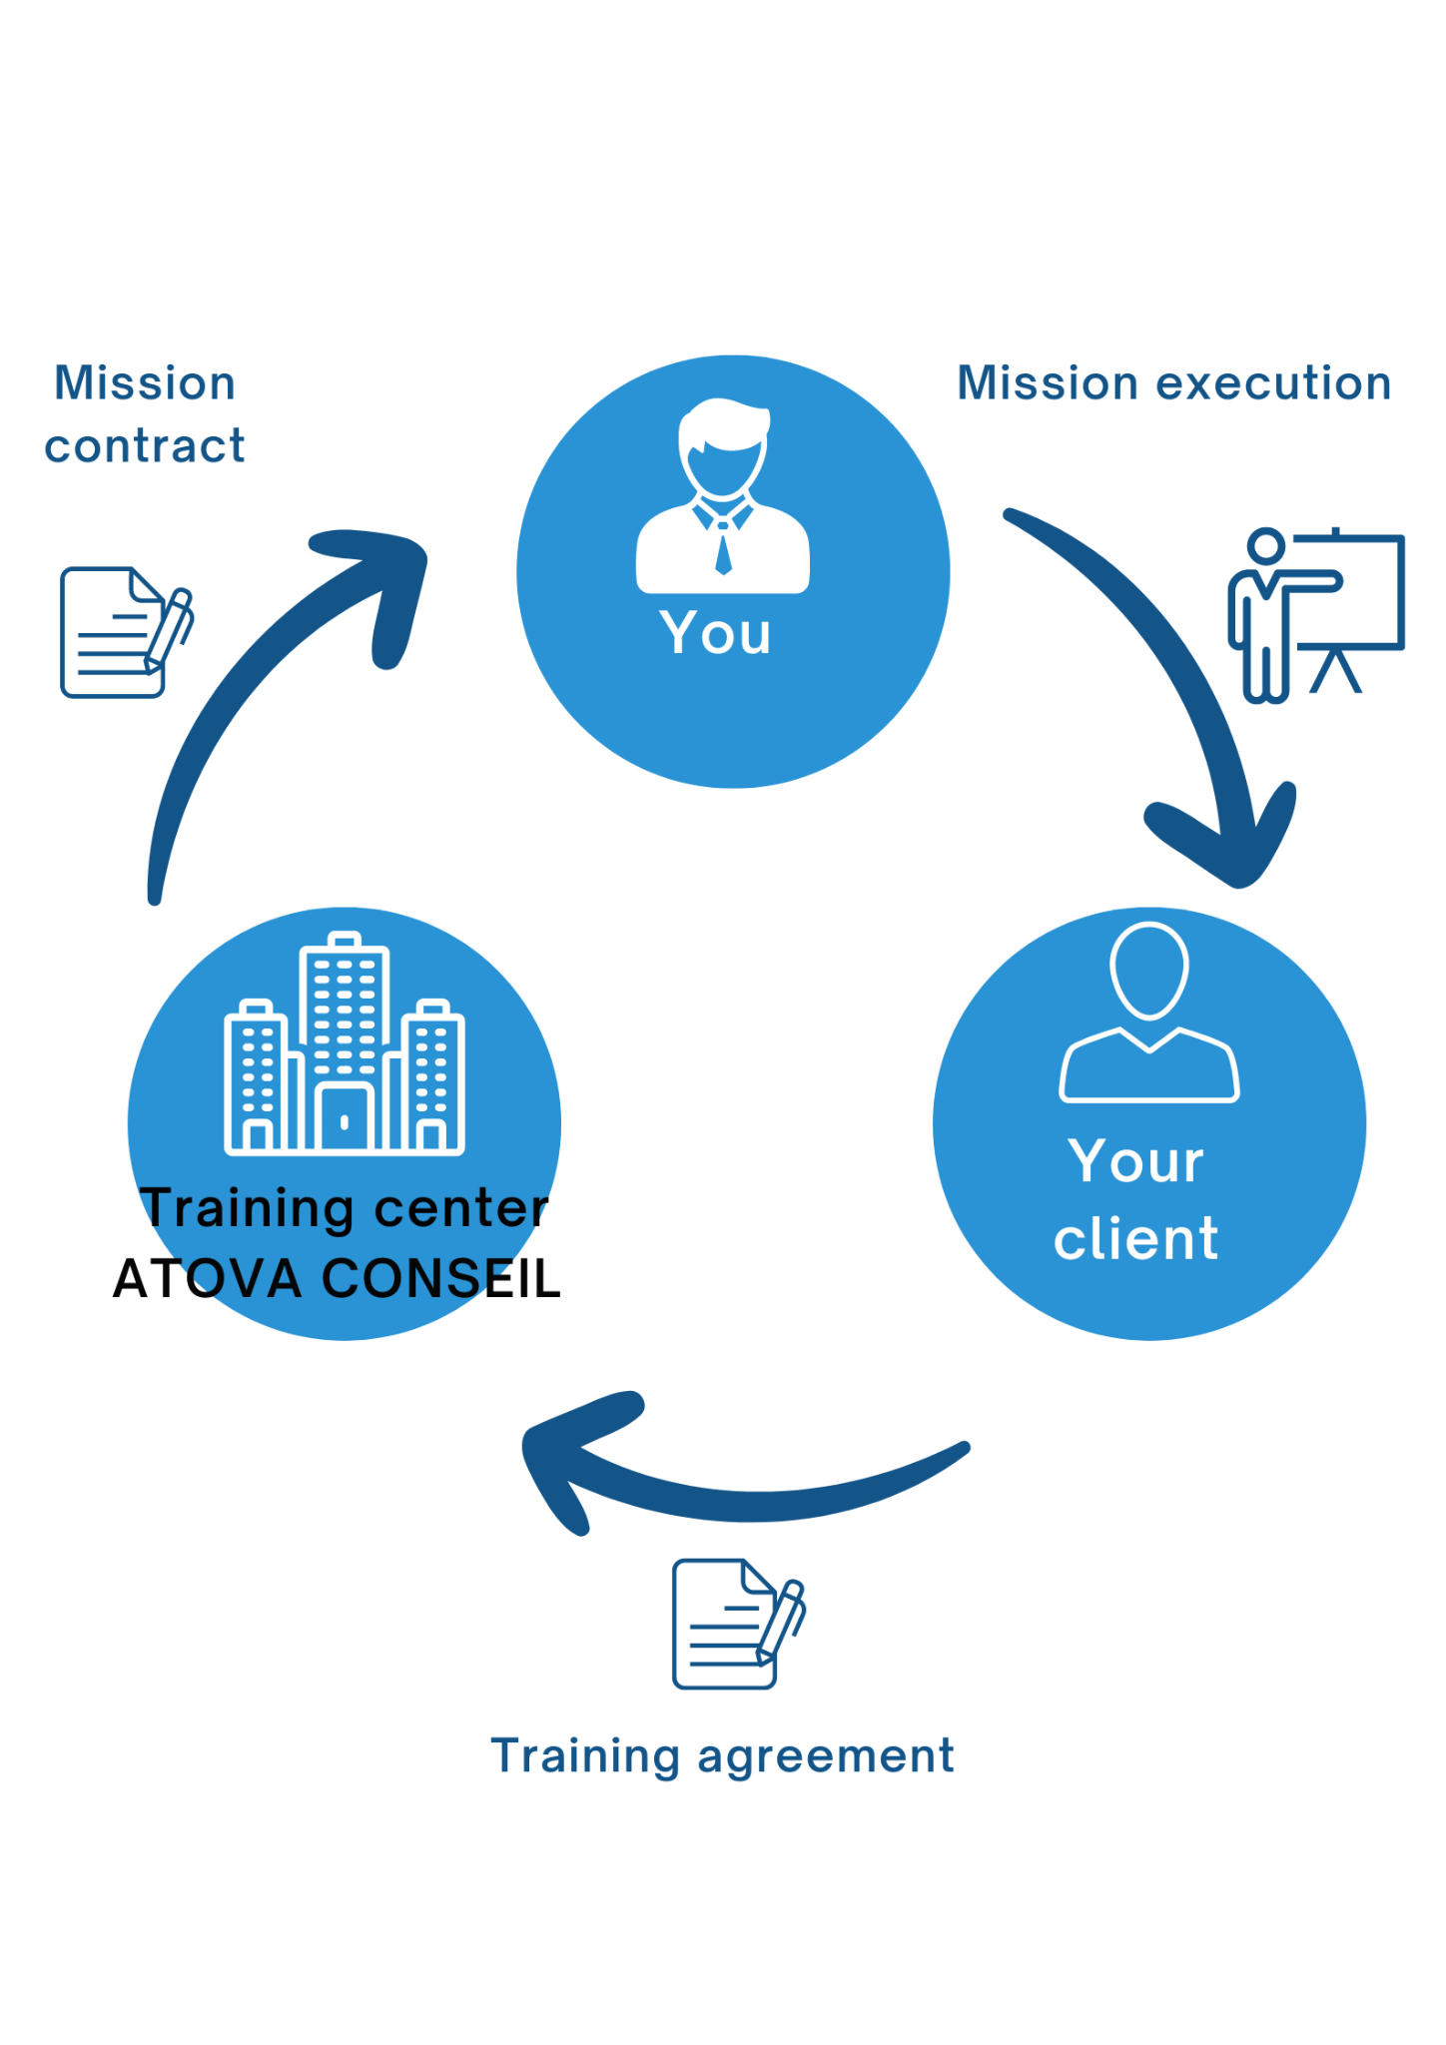
Qualiopi portage, an asset for your business
Atova offers a training program distribution platform. Once the programs are submitted, they can be published and disseminated on our website, which experiences a consistently growing web traffic. On average, we receive over 30 training requests per week, and our catalog features over 250 training programs.
Our goal is to enhance our catalog and enable you to leverage our Qualiopi certification through portage services.
Qualiopi portage

Slide 5
How our training center can help: publishing your offerings on our platform
Registration process for your training through the distribution service
Average processing time: 24 hours
1
2
3
4
5
Google indexing
Confirmation of receipt
Swift publishing of the training
Enter the data in the form
Identify the training programs you wish to publish.
We will provide you with a permanent link to do so .
We will confirm the receipt and verify the content.
We will publish your training on our website.
Publication on Google within 15 days.
Here is an example of a training plan : https://www.jetrouvemaformation.com/formation_Finance-Gestion-Compta-Droit-des-affaires/formation_Mise-en-place-du-dispositif-de-cartographie-des-risques-et-du-Plan-de-Continuite.html

Slide 6

How our training center can help
Simplified management process for a file through the management service
The client has everything in place to be funded by OPCOs.
1
2
3
4
5
6
You sell the training to your client
You coordinate with Atova regarding the date and location
Atova contacts the client to have the training agreement signed
Atova communicates with your trainer and provides the evaluation questionnaire and attendance sheet
Atova invoices the client
The partner invoices Atova.

Slide 7

How our center is remunerated
distribution offer
management offer
full-service offer
Good to know:
The distribution offer corresponds to the transmission of a business opportunity. All subsequent interactions take place between you and the client. The commission is 10% (excluding taxes) of the provided dossier amount.
The management offer corresponds to the complete administrative management of a training file in accordance with the requirements of the Qualiopi standard. The commission is 15% (excluding taxes) of the dossier amount.
The full-service offer corresponds to a situation where a client is referred to you through our intermediary and is administratively managed by us. The commission is 25% (excluding taxes) of the dossier amount.
Net amount of your training project
15 %
25 %
10 %
Commission rate

Slide 8





Successful partnership case
The partnership between Actuelia and Atova Conseil started in 2013 and has been beneficial for both companies.
Actuelia has experienced an increase in revenue and reputation due to improved commercial offer conversion.
The platform has found three training programs for Actuelia.
Additionally, Actuelia aimed to assist its own clients in securing funding for 17 training projects with the help of Atova.
3
13
20
40 k€
Clients found
Trainings uploaded online.
Processed client files.
of generated revenue.

Slide 9

Who can be our partners?
Our partnership is aimed at companies that have expertise to disseminate and are looking to increase their revenue and reputation. This includes consulting and organizational firms, governance advisory firms, audit, actuarial, and taxation firms, investment banks, and more.

Slide 10
Conclusion
By partnering with us, you give yourself the opportunity to:
Freely distribute your training programs on a well-referenced platform.
Benefit from the expertise of a specialized team in professional training and administrative management.
Improve customer satisfaction and loyalty, as your future training programs can be funded by OPCOs.
We invite you to explore collaboration opportunities with us, without any commitment on your part. Please contact me for a detailed discussion on my proposal, and together, we will determine how we can achieve your objectives.

Slide 11
Thank you for your attention
I invite you to contact me to discuss in more detail.
Fabien Ben Sadoun
+33 4 81 91 61 56 or +33 7 56 96 40 62
f.bensadoun@atova-conseil.com

